Slide 1
LINKAGE & CROSSING OVER
M.V.V.S.GANGA BHAVANI
LECTURER IN BOTANY
P.R.GOVT COLLEGE(A), KAKINADA

Slide 2
KINDS OF LINKAGE
Linkage is of two types.
They are: (i) Complete and (ii) Incomplete linkage, depending upon the absence or presence of non-parental (recombinant) combinations of linked genes in the test cross progeny.

Slide 3
COMPLETE LINKAGE
It is the phenomenon in which linked genes are transmitted together to the offsprings only in their original or parental combination for two or more generations.
In this case, the linked genes are closely associated and do not separate to form the new or non - parental combinations.
As a result, only parental character combinations are recovered in test cross progeny.
Complete linkage is a very rare phenomenon.
According to BRIDGE all the genes of male Drosophila remain completely linked.

Slide 4
Example: Complete linkage in Maie Drosophila:
In Drosophila, grey body colour is dominant (B) over black colour (b) and long wings (V) is dominant over vestigial wings (v).
When a fly with grey body and vestigial wings (BBvv) is crossed with black body and long wings (bbVV), the F, hybrid showed grey body and long wings (BbVv).
When the F1 hybrid is test crossed with the double recessive female, the offspring showed two types of flies in equal proportion.
They are: 50% grey, vestigial flies and 50% black, long flies.
Thus, the offspring resemble the two grand parents.
The results indicate that grey body character is inherited together with the vestigial wings.
It means that the two genes are linked. Similarly, black body character is associated with the long wings.
This shows complete linkage.

Slide 5
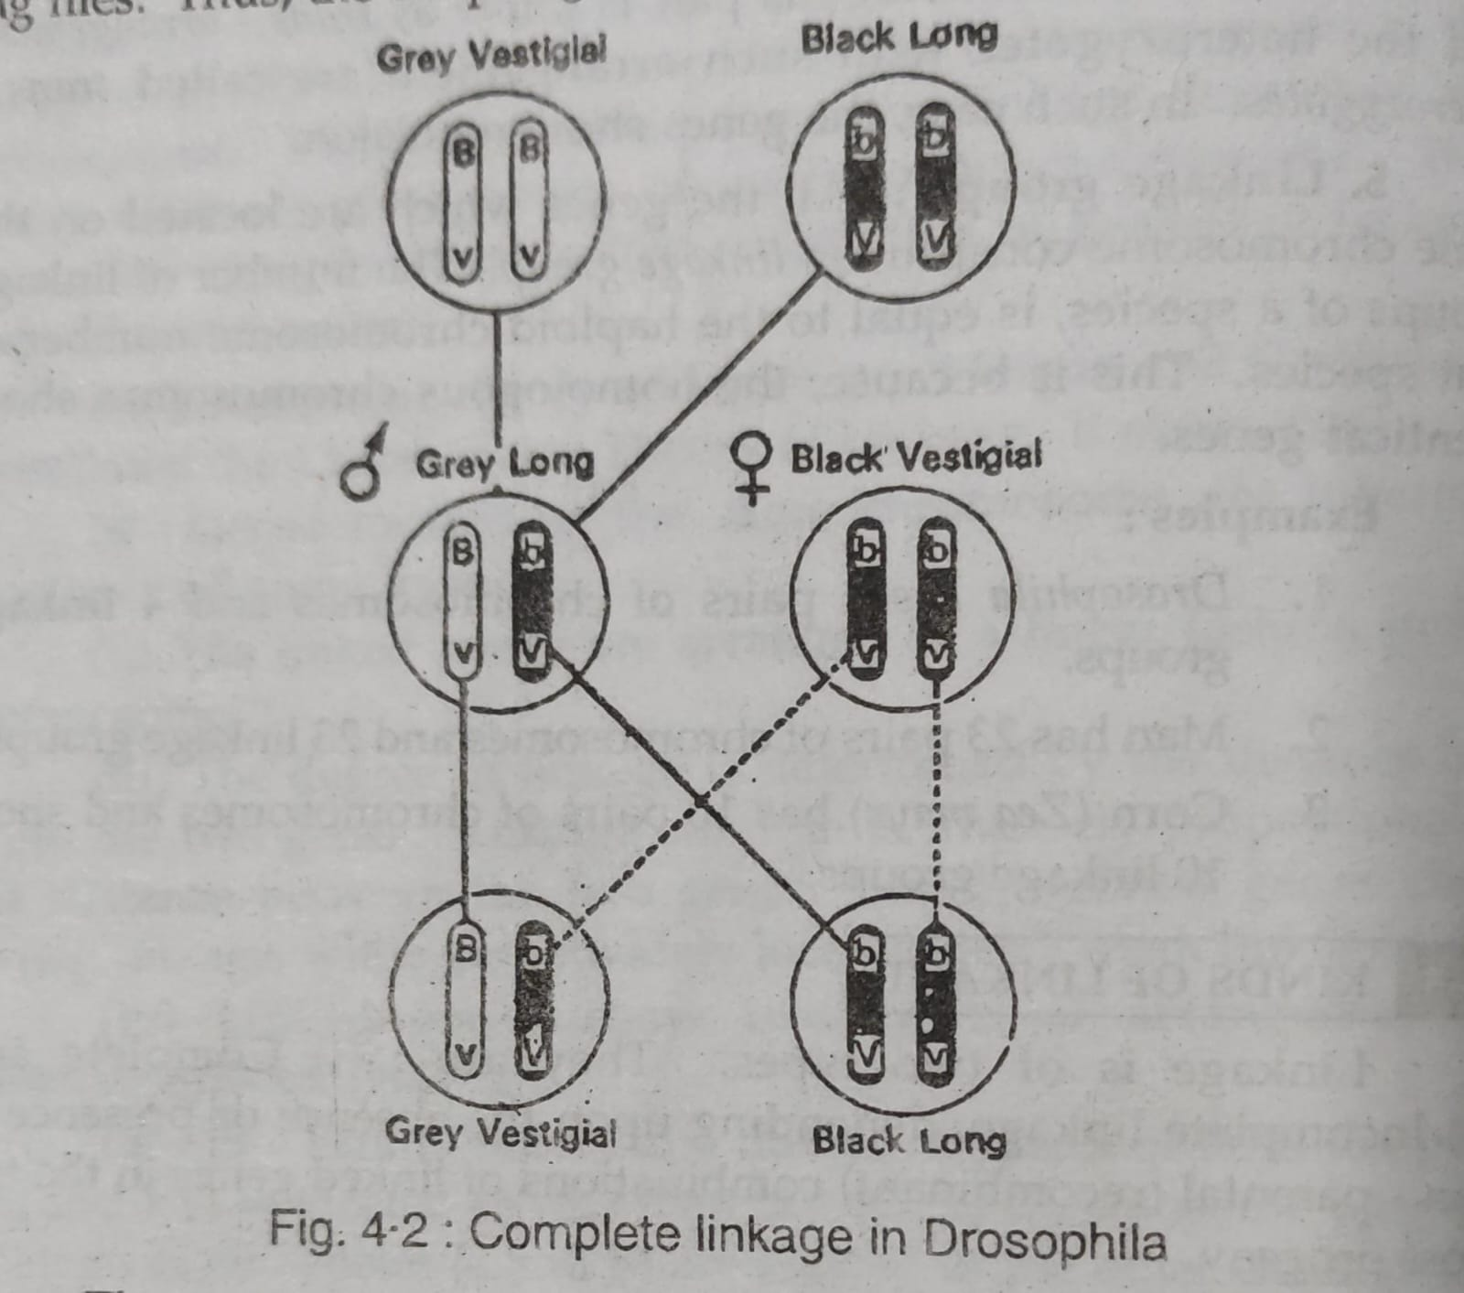

Slide 6
INCOMPLETE LINKAGE:
In majority of cases, the homologous non sister chromatids exchange segments with one another during meiotic prophase (pachytene) by process of crossing over.
This leads to formation of new combinations among the young ones.
This phenomenon is called incomplete linkage.
Incomplete linkage is very common and has been studied in almost all the organisms.

Slide 7
Example: Incomplete linkage in Maize:
Hutchinson (1922) crossed a variety of maize having coloured and normally filled seeds with another variety having colourless and shrunken seeds.
All the F1 plants produced coloured and filled seeds.
But in a test cross, when the F1 dihybrid female is cross pollinated with pollen from a plant with colourless and shrunken seeds (double recessive), four types of seeds are produced in the following proportion.
(i) Coloured, full (CS / cs) - 4032 - 48%
(ii) Coloured, shrunken (Cs / cs) - 149 - 2%
(iii) Colourless, full (cS / cs) - 152 - 2%
(iv) Colourless, shrunken (cs / cs) - 4035 - 48%

Slide 8
The test cross results are clearly showing that the parental combinations of alleles (e.g. CS/Cs and cs/cs) were more numerous than the new combinations (e.g. Cs/cs and Cs/cS).
This clearly indicates that these characters are held (linked) together and the genes are located in the same chromosomes (Coupling phase).
Only 4% individuals have recombination showing incomplete linkage.

Slide 9
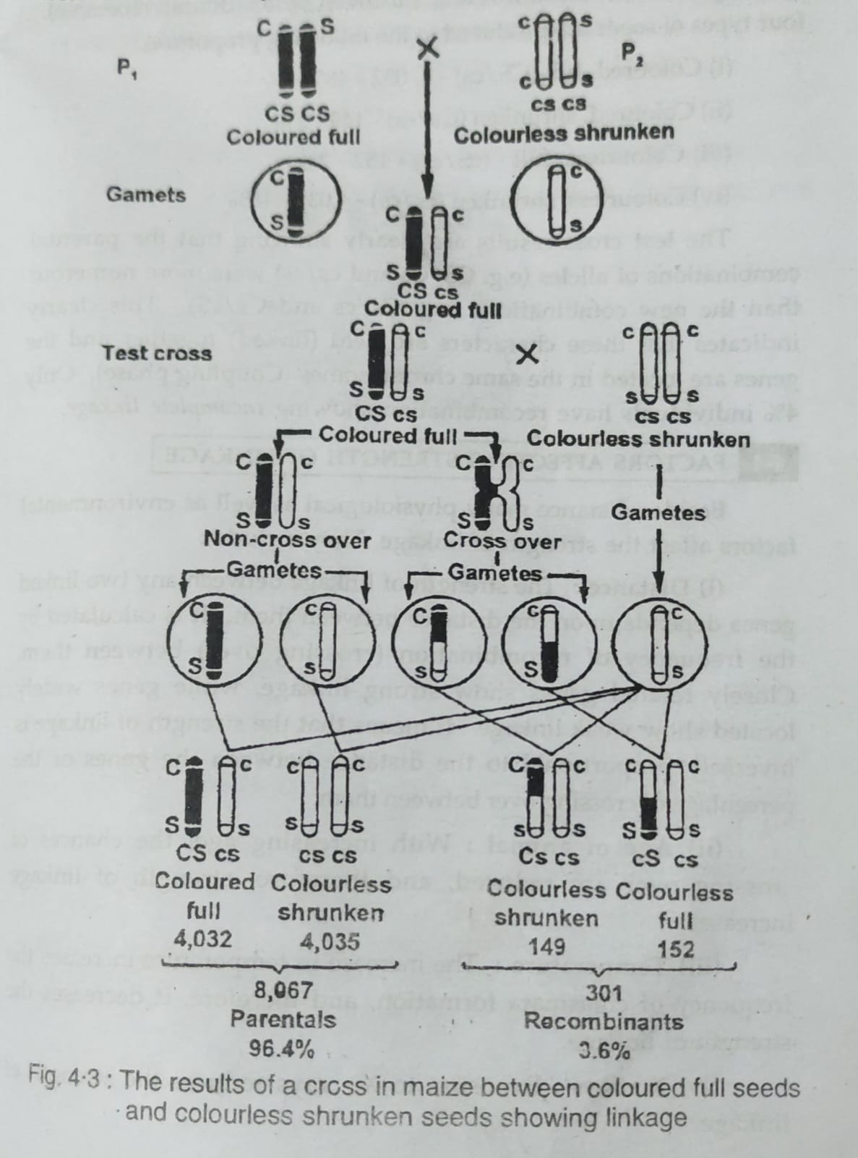

Slide 10
FACTORS AFFECTING STRENGTH OF LINKAGE
Besides distance many physiological as well as environmental factors affect the strength of linkage. They include:
(i) Distance: The strength of linkage between any two linked genes depends upon the distance between them. The strength of linkage is inversely proportional to the distance between the genes or the percentage of crossing over between them.
(ii) Age of animal: With increasing age, the chances of rossing over are reduced, and therefore, strength of linkage increases.
(iii) Temperature: The increase in temperature increases the frequency of chiasmata formation, and therefore, it decreases the strength of linkage.
(iv) X-rays: Exposure to X rays reduces the strength of linkage.

Slide 11
SIGNIFICANCE OF LINKAGE
The phenomenon of linkage has great significance for living organisms, because it reduces the possibility of variation in gametes unless crossing - over separate the linked genes.

Slide 12
CROSSING OVER
Definition:
Crossing - over may be defined as "the exchange of homologous segments between non sister chromatids of homologous chromosomes".
FREQUENCY OF CROSSING OVER :
The frequency with which crossing - over occurs between two genes is expressed in terms of percentage of crossing Normally, the percentage of crossing over is directly proportional to the distance between the genes.
If the distance between the two genes is more, the chances of crossing over and chiasmata formation are more and vice versa.
Thus, the percentage of crossing over between two genes indicate the distance between the two genes.
This fact is of great significance, in working out the relative distances between the genes in a chromosome.
The percentage of crossing over is the expression of the number of recombinations in percentage to the total number of offspring.

Slide 13
Frequency of crossing over (%)
= No.of recombinant individuals from a Test cross _______________________________________
Total number of progeny in the Test crossx 100

Slide 14
MECHANISM OF CROSSING-OVER
Crossing over is the interchange of chromosomal segments between non- sister chromatids.
It occurs during gametogenesis in which the meiotic cell division takes place.
During the zygotene sub - stage (prophase - 1), the homologous chromosomes move towards each other and come to lie side by side.
This pairing is very precise and is brought about by the mutual attraction between two homologous regions of chromosomes.
The resultant pairs of homologous chromosomes are called bivalents. This phenomenon is called synapsis.

Slide 15
In pachyene stage, each chromosome of a bivalent, splits longitudinally to form two sister chromatids.
Thus, the bivalent now consists of four chromatids and is know as the tetrad.
The non- sister chromatids of homologous chromosomes twist over each other.
These points of contact between non sister chromatids produce a cross (x) like figure and are called chiasmata (Chiasma = singular).
At the chiasmata, the chromatids break, by the activity of an enzyme called endonulcease.
Then, the broken segment of one chromatid is fused with the other chromatid and vice versa.

Slide 16
This fusion is brought about by another enzyme called ligase.
This exchange of chromatid segments between non sister chromatids is called crossing over.
The crossing over, thus, includes the breaking of chromatid segments, their transportation and fusion.
After the completion of crossing over, the non sister chromatids repel each other, because the force of synapsis attraction between them decreases.
During diplotene, desynapsis begins, and the two homologous chromosomes in a bivalent are pulled away from each other.
The chiasmata also start moving in a zipper like fashion towards the ends of the tetrad.
This movement of chiasma called terminalization.
Simultaneously, the chromatids get shortened and in diakinesis, the homologous chromosomes become separated except at their ends.

Slide 17
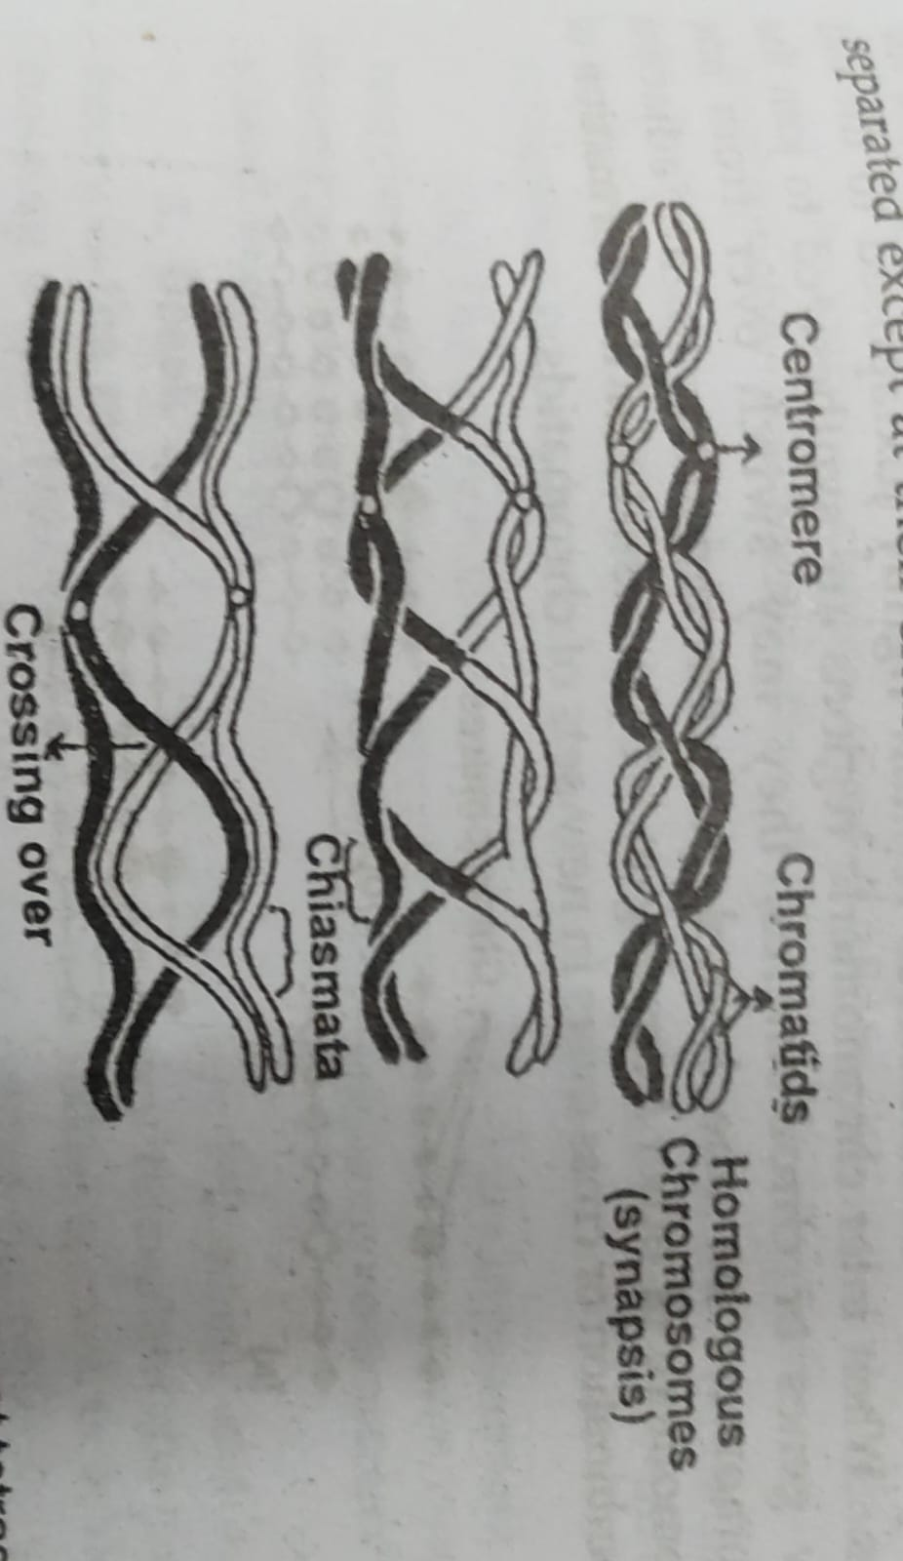

Slide 18
THEORIES EXPLAINING THE MECHANISM OF CROSSING OVER
Following theories have been put forwarded to explain the mechanism of crossing over.
1. Duplication Theory:
This theory was proposed by Joh Belling (1928) while studying meiosis in some plant species.
He believed that crossing over and recombination might occur during replication of homologous chromosomes.
During duplication of chromosomes, initially the chromomeres are duplicated and the newly formed chromomeres remain tightly juxtaposed to the old ones.
When inter chromomeric regions are synthesized to join the new genes or chromomeres, they may switch over from one chromomere on one homologus chromosome to an adjacent chromomere of other homologue.
This results in the formation of recombination or cross overs in new sets of chromatids.

Slide 19
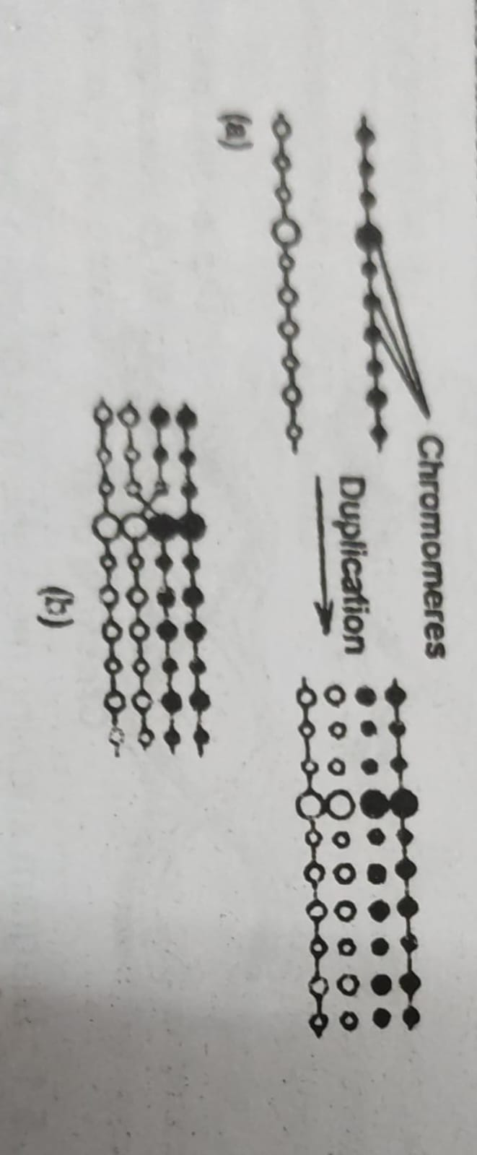

Slide 20
2. Copy-choice Hypothesis:
To explain recombination in micro organisms, Laderberg (1955) proposed a modified version of Belling's hypothesis.
This is called copy choice mechanism.
According to this model, a daughter chromosome is formed by alternate use of recipient and donor chromosome material as a kind of model or template. The daughter chromosome is then like the maternal chromosome except for the portions 'copied from the chromosome segment.
At the end of process a recipient cell would contain (a) the original donor segment, (b) the original recipient whole chromosome and (c) a hybrid daughter chromosome.

Slide 21
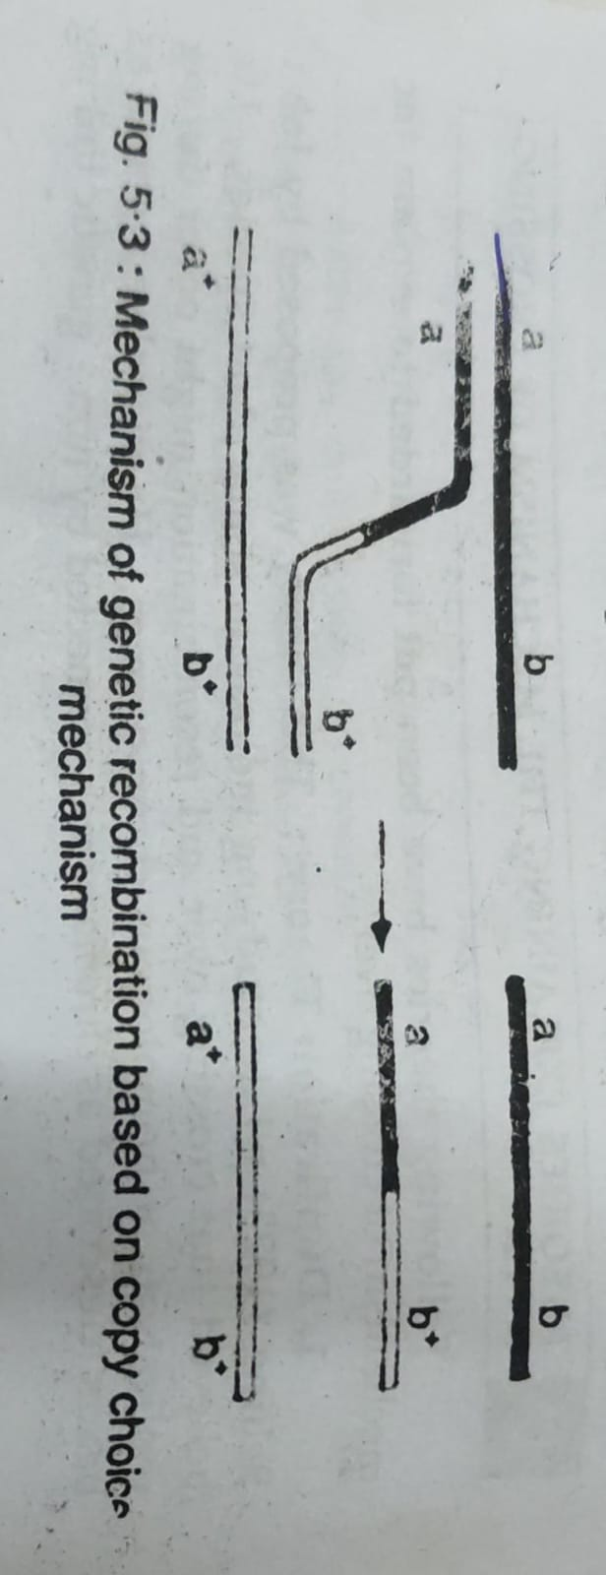

Slide 22
3. Break and Exchange Theory:
The break and exchange theory is the most widely accepted theory to explain the process of crossing over.
This theory states that crossing over is achieved by the breakage and exchange of chromosomal segments between the non- sister chromatids.
Following theories have been proposed to explain the process of breakage of chromatids.
(i) Serebrovsky's contact first theory: This theory holds that the non sister chromatids of a homologous pair, first touch and twist over each other. At the point of contact, the chromatids break and the broken segments, then rejoin to form new combinations.
(ii) The Breakage First Theory: This was proposed by Muller. According to this theory, the chromosomes first break into two or more segments. The broken segments of non sister chromatids then rejoin with an exchange forming chiasma.

Slide 23
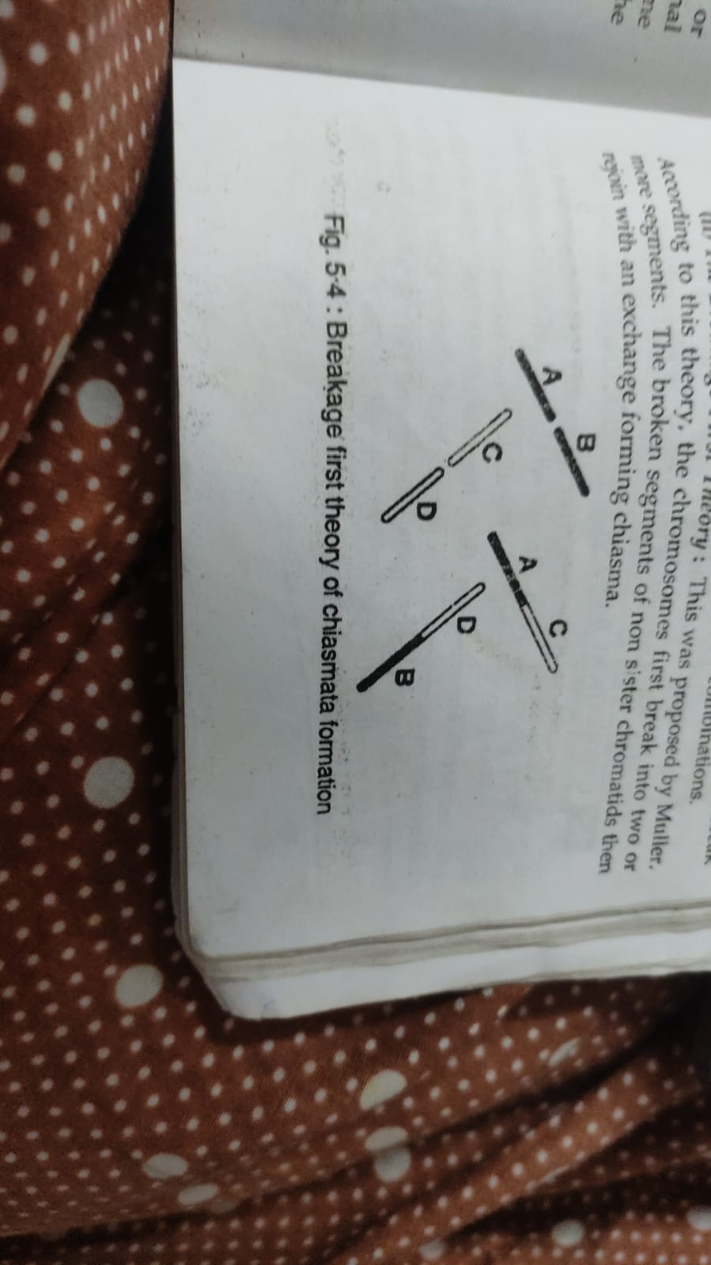

Slide 24
(iii) Darlington's strain or torsion Theory:
Darlington (1935) proposed that chromosomal breakage occurs as a result of strain during meiotic pairing.
According to this theory the homologous chromosomes pair and become spirally twisted around each other.
Due to twists, the coils are formed and these are known as relational coils.
Then, there develops strain on a chromatids.
As a result of strain due to torsion of chromosomes, the chromatids, of the chromosomes break at the points of contact and, thus recombination results.

Slide 25
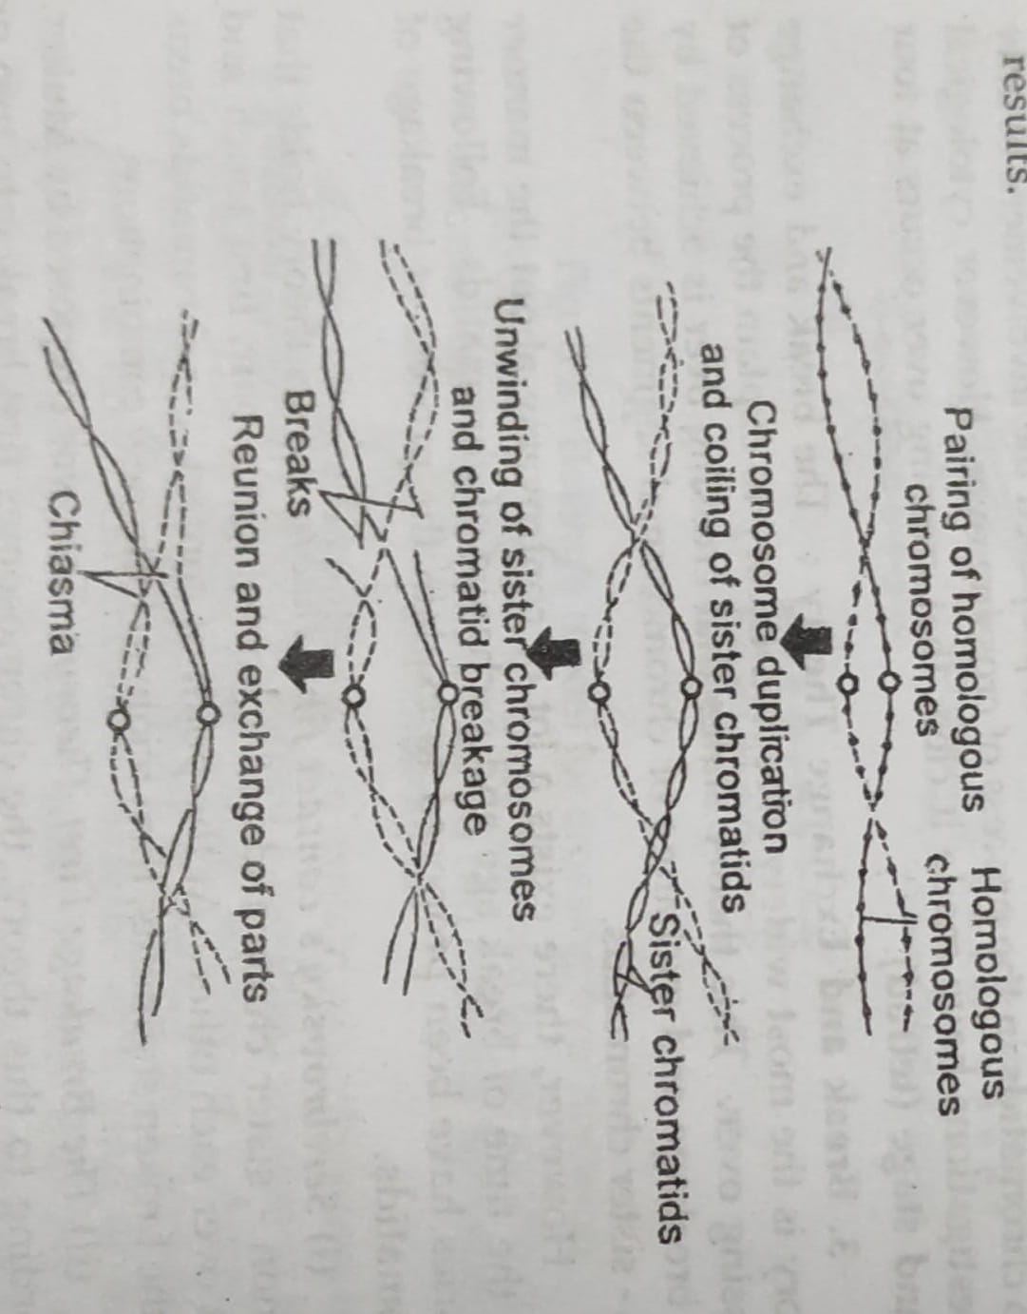

Slide 26
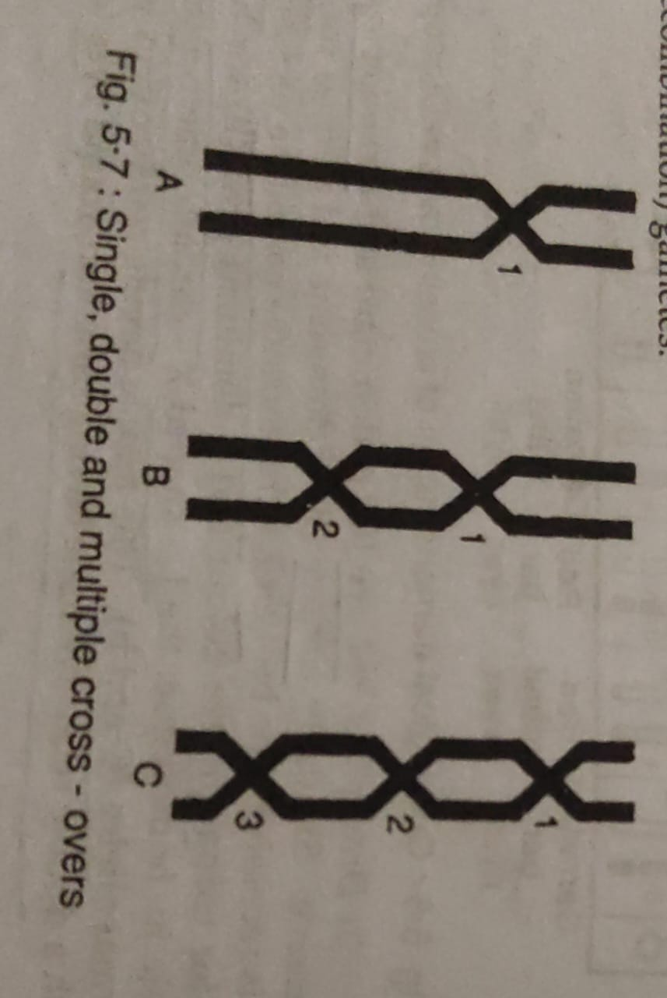
KINDS OF CROSSING OVER
Depending upon the number of chiasmata formed, crossing over may be of the following types.
1.Single crossing over:- one chiasmata.
2. Double crossing over:- chiasmata occurs at 2 points.
3.Multiple crossing over :- Chiasmata occurs at more than 2 points.

Slide 27
SIGNIFICANCE OF CROSSING OVER
Crossing over is universal phenomenon and has a great significance in genetics.
It provides a direct evidence for the linear arrangement of genes in the chromosomes.
The frequency of crossing over helps in the construction of chromosome maps.
New gene combinations are produced.

Slide 28


